Slide 1
Lecture 31

Slide 2
Energy Transfer Mechanisms

Slide 3
Methods of Heat Transfer
Need to know the rate at which energy is transferred
Need to know the mechanisms responsible for the transfer
Methods include
Conduction
Convection
Radiation

Slide 4
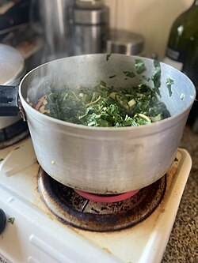
Conduction
The transfer can be viewed on an atomic scale
It is an exchange of energy between microscopic particles by collisions
Less energetic particles gain energy during collisions with more energetic particles
Rate of conduction depends upon the characteristics of the substance

Slide 5
Conduction example
The molecules vibrate about their equilibrium positions
Particles near the stove coil vibrate with larger amplitudes
These collide with adjacent molecules and transfer some energy
Eventually, the energy travels entirely through the pan and its handle

Slide 6
Conduction, cont.
In general, metals are good conductors
They contain large numbers of electrons that are relatively free to move through the metal
They can transport energy from one region to another
Conduction can occur only if there is a difference in temperature between two parts of the conducting medium

Slide 7
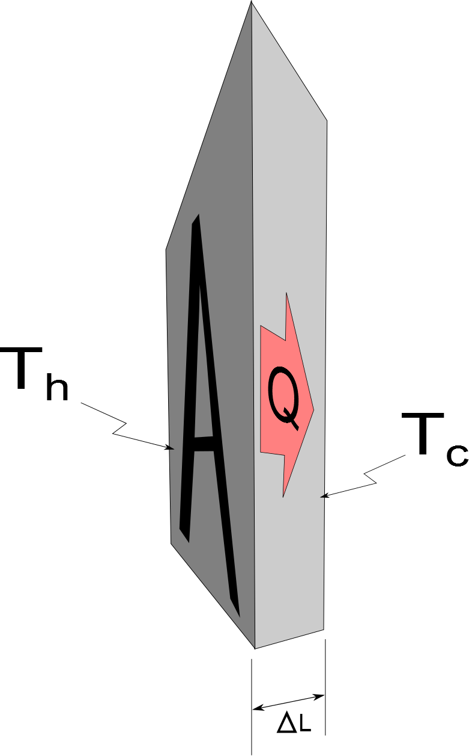
Conduction, equation
A
The slab allows energy to transfer from the region of higher temperature to the region of lower temperature

Slide 8
Conduction, equation explanation
A is the cross-sectional area
ΔL is the thickness of the slab or the length of a rod
P is in Watts when Q is in Joules and t is in seconds
k is the thermal conductivity of the material
See table 11.3 for some conductivities
Good conductors have high k values and good insulators have low k values

Slide 9
Home Insulation
Substances are rated by their R values
R = ΔL / k
See table 11.4 for some R values
For multiple layers, the total R value is the sum of the R values of each layer
Wind increases the energy loss by conduction in a home

Slide 10
Multiple Materials, cont.
The rate through the multiple materials will be
T_{H} and T_{C} are the temperatures at the outer extremities of the compound material

Slide 11
Convection
Energy transferred by the movement of a substance
When the movement results from differences in density, it is called natural conduction
When the movement is forced by a fan or a pump, it is called forced convection

Slide 12
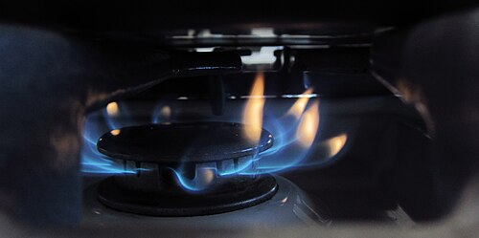
Convection example
Air directly above the flame is warmed and expands
The density of the air decreases, and it rises
The mass of air warms the hand as it moves by

Slide 13
Convection applications
Boiling water
Radiators
Upwelling
Cooling automobile engines
Algal blooms in ponds and lakes

Slide 14
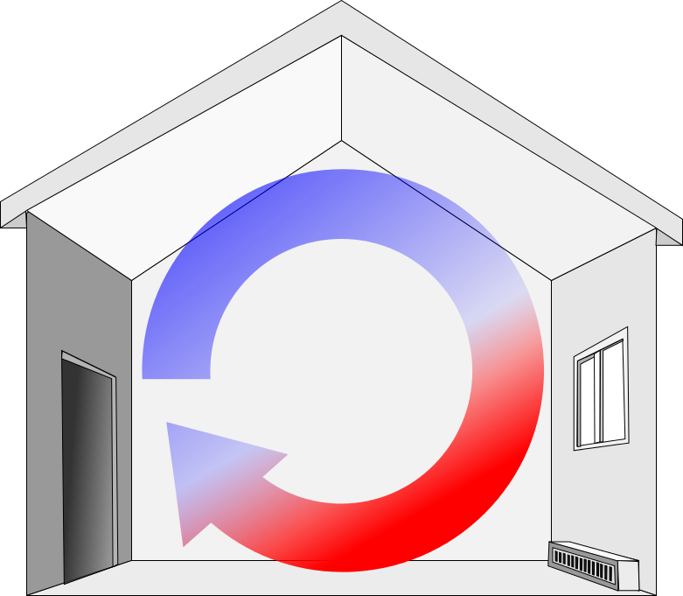
Convection Current Example
The radiator warms the air in the lower region of the room
The warm air is less dense, so it rises to the ceiling
The denser, cooler air sinks
A continuous air current pattern is set up as shown
Electric Base-Board Heater

Slide 15
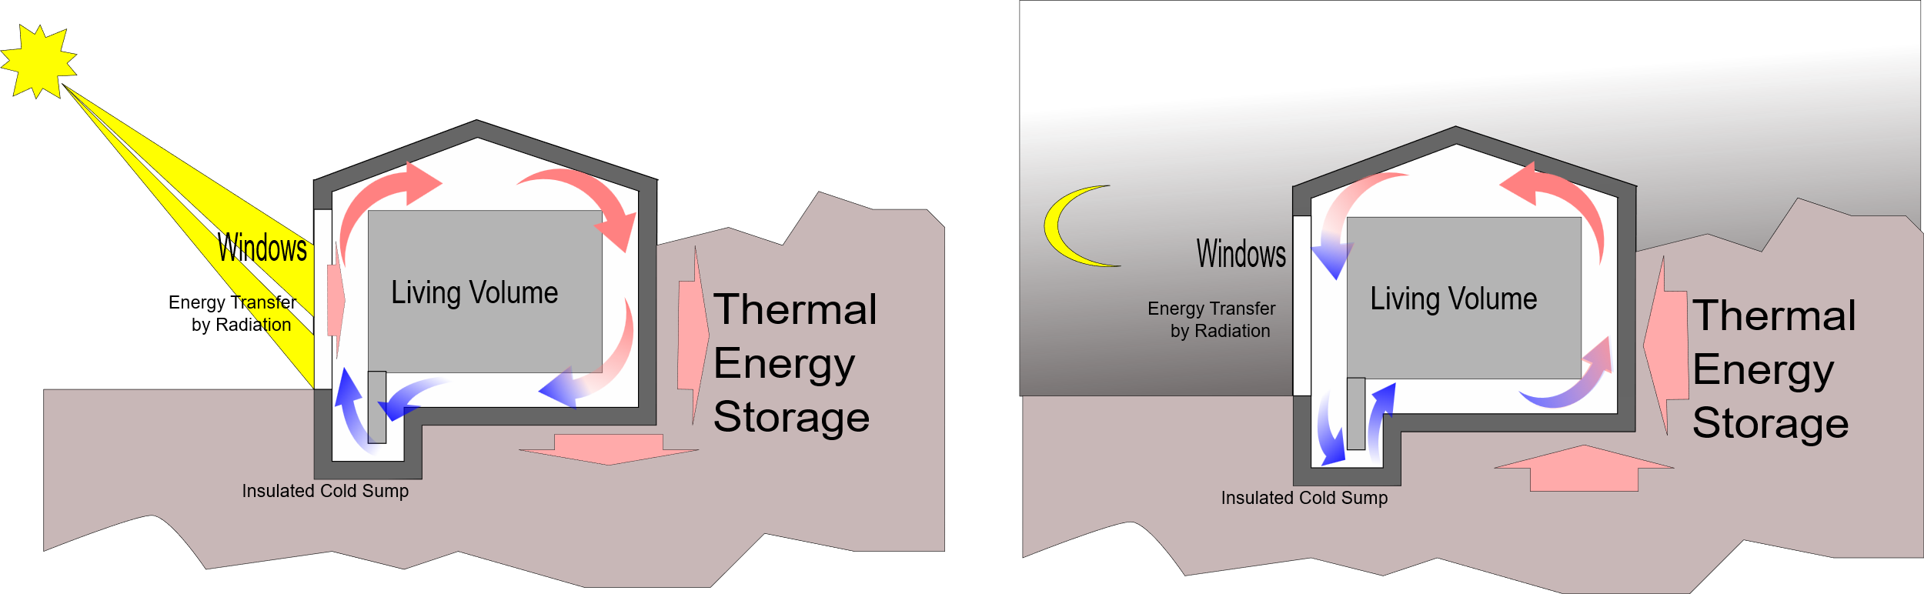
Passive Convection Heating

Slide 16
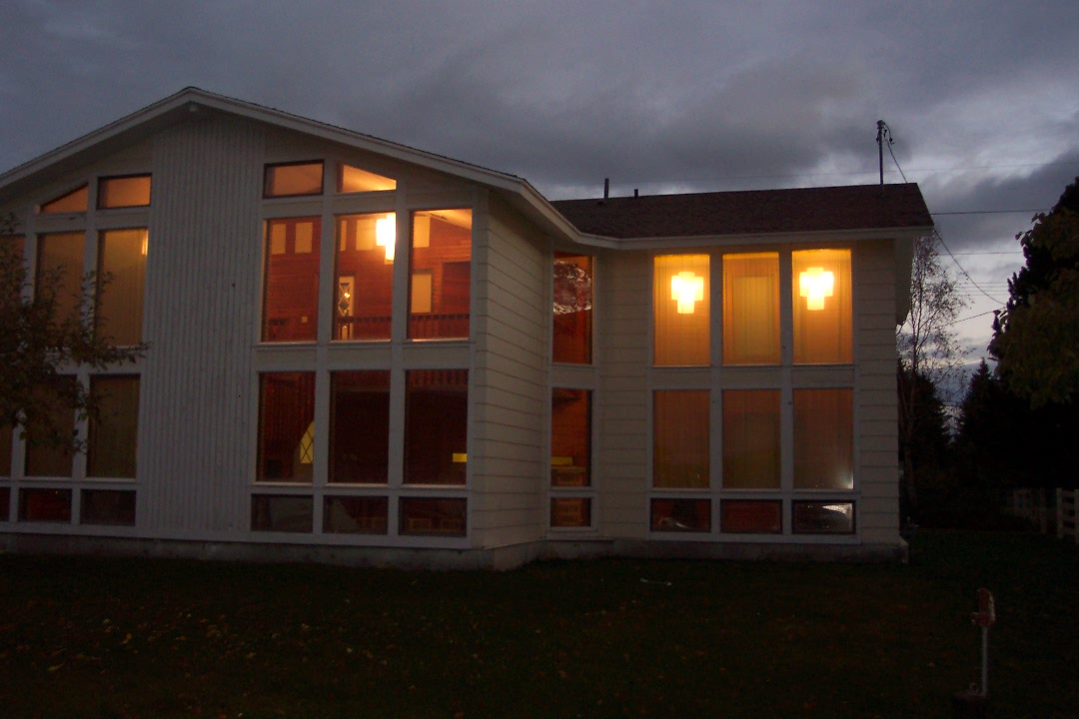
House Pictures

Slide 17

Upwelling

Slide 18
Radiation
Radiation does not require physical contact
All objects radiate energy continuously in the form of electromagnetic waves due to thermal vibrations of the molecules
Rate of radiation is given by Stefan’s Law

Slide 19
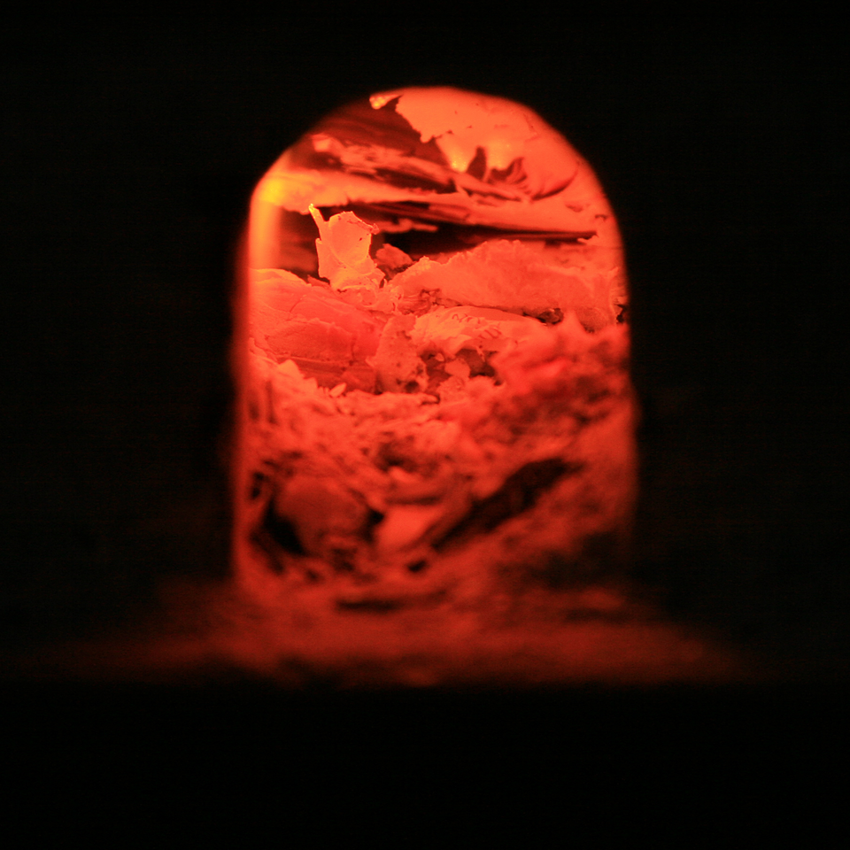
Radiation example
The electromagnetic waves carry the energy from the fire to the hands
No physical contact is necessary
Cannot be accounted for by conduction or convection

Slide 20
Radiation equation
The power is the rate of energy transfer, in Watts
σ = 5.6696 x 10⁻⁸ W/m^{2.}K⁴
A is the surface area of the object
e is a constant called the emissivity
e varies from 0 to 1
T is the temperature in Kelvins

Slide 21
Energy Absorption and Emission by Radiation
With its surroundings, the rate at which the object at temperature T with surroundings at T_{o} radiates is
When an object is in equilibrium with its surroundings, it radiates and absorbs at the same rate
Its temperature will not change

Slide 22
Ideal Absorbers
An ideal absorber is defined as an object that absorbs all of the energy incident on it
e = 1
This type of object is called a black body
An ideal absorber is also an ideal radiator of energy

Slide 23
Ideal Reflector
An ideal reflector absorbs none of the energy incident on it
e = 0

Slide 24
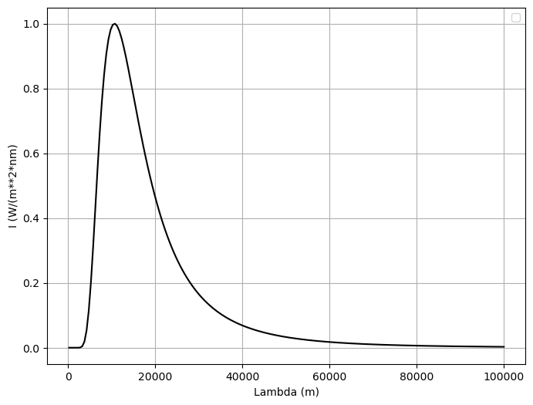

Slide 25
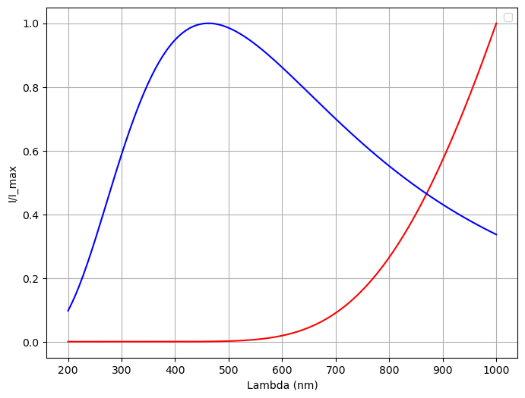
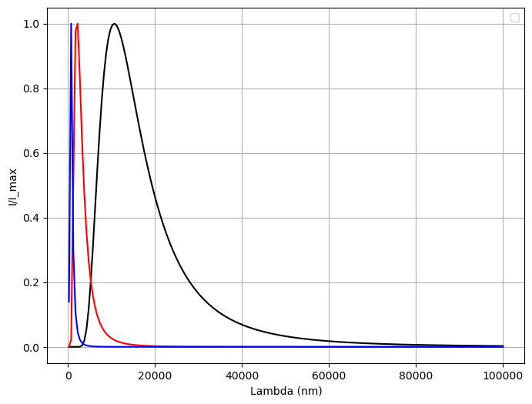

Slide 26
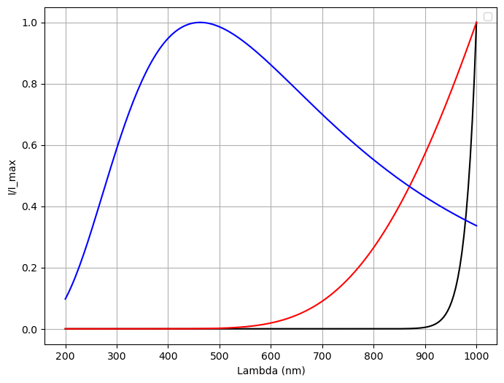

Slide 29
Applications of Radiation
Clothing
Black fabric acts as a good absorber
White fabric is a better reflector
Thermography
The amount of energy radiated by an object can be measured with a thermograph
Body temperature
Radiation thermometer measures the intensity of the infrared radiation from the eardrum

Slide 30
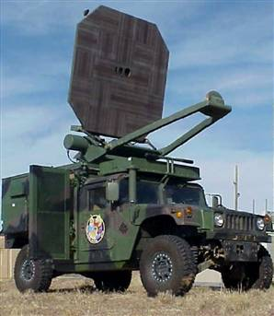
Radiation Example
Developed by the Air Force, the so-called "Active Denial System" (ADS) fires out milimeter waves -- a sort of cousin of microwaves, in the 95 GHz range. The invisible beams penetrate just a 64th of inch beneath the skin. But that's deep enough to heat up the water inside a person. Which is enough to cause excruciating pain.
http://www.defensetech.org/archives/002035.html

Slide 31
Global Warming
Greenhouse example
Visible light is absorbed and re-emitted as infrared radiation
Convection currents are inhibited by the glass
Earth’s atmosphere is also a good transmitter of visible light and a good absorber of infrared radiation
The Earth’s radiation budget (whether we have a positive or negative amount of energy transfer is hotly debated

Slide 32
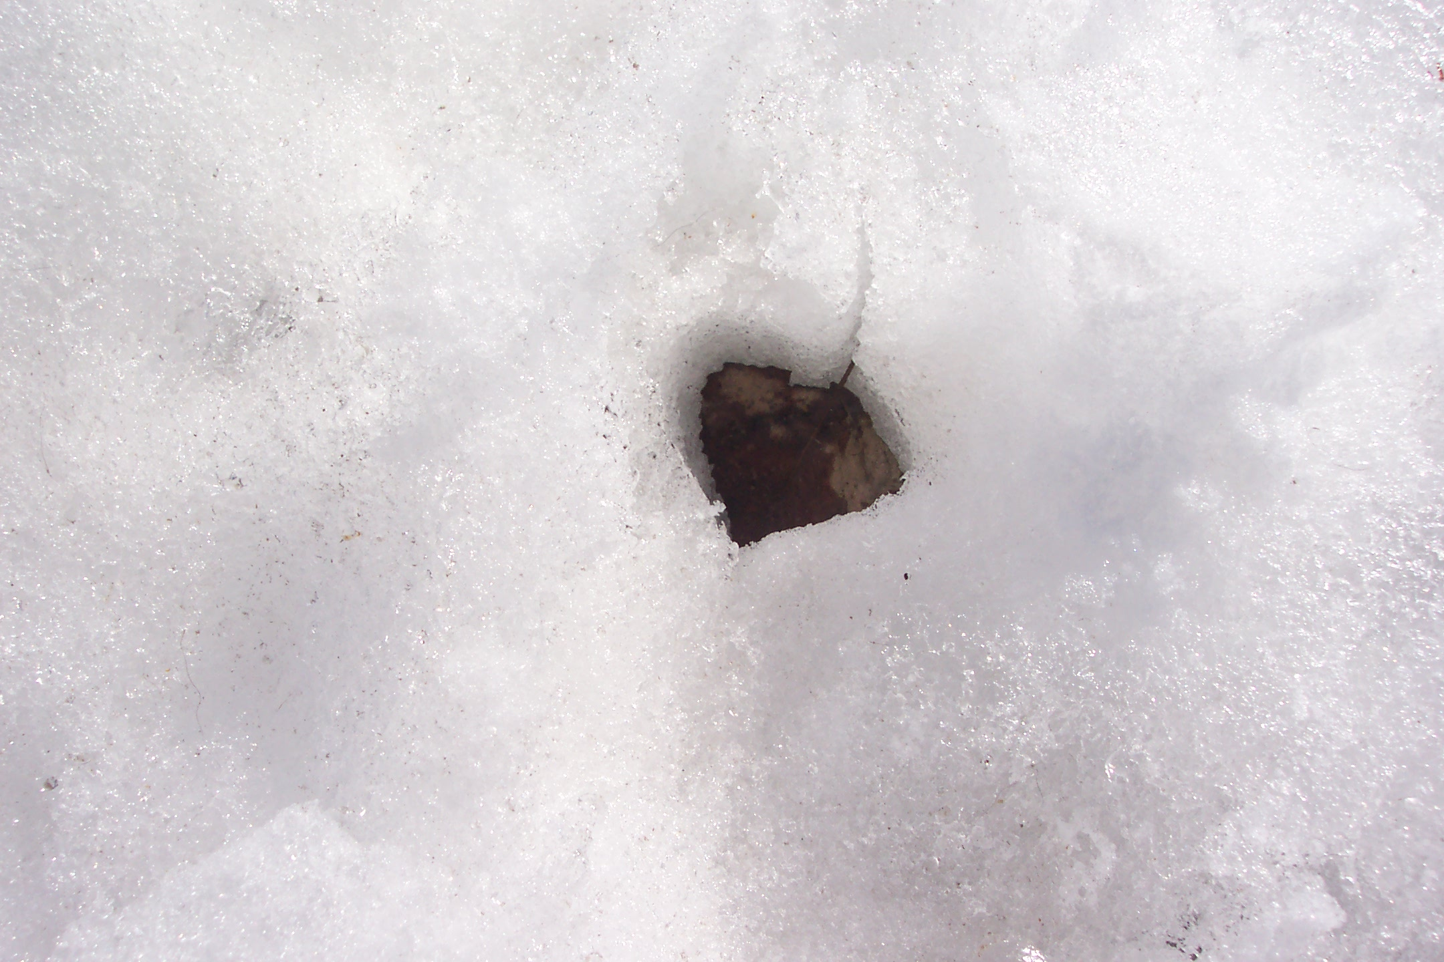
Question 123.13.5
You go outside on a cold spring morning in Rexburg. You see a leaf in the snow
The leaf seems to have sunk in the snow. What is the most likely reason for this?
The leaf is very massive so the force of gravity pulls it through the snow
The leaf has a different emissivity than the snow, so it absorbs more radiation from the sun, the temperature of the leaf rises and it melts the snow around it.
There was a very carful dog that stepped on the leaf, smashing it into the snow.

Slide 33
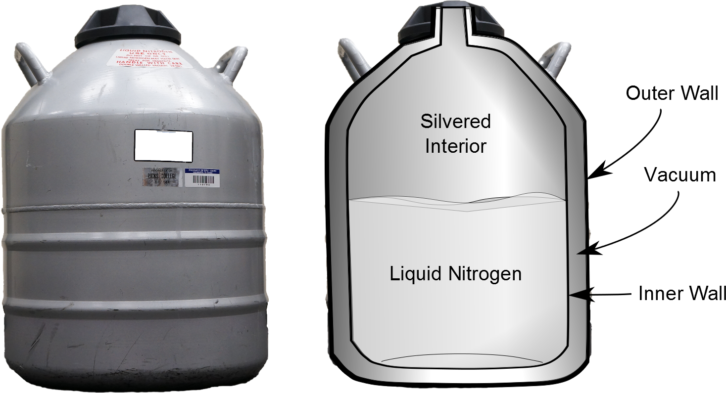
Resisting Energy Transfer
Dewar flask/thermos bottle
Designed to minimize energy transfer to surroundings
Space between walls is evacuated to minimize conduction and convection
Silvered surface minimizes radiation
Neck size is reduced

Slide 34
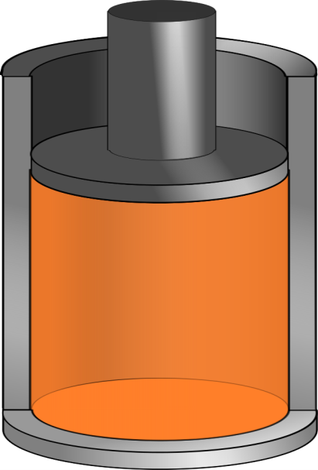
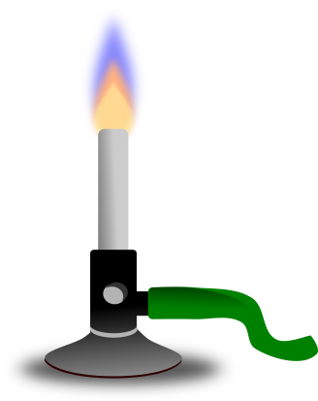
Q negative
Q positive

Slide 35
Question 123.9.4
Does the curve fit match the data?
Yes
No

Slide 36
Question 123.9.5
Does the curve fit match the data in the range
-6<x<5?
Yes
No

Slide 37
Question 123.9.6
Could the curve fit in the range
-6<x<5?
be useful?
Yes
No

Slide 38

V
P
A

Slide 41
Question123.9.7 Ideal Gas Law I
Two identical cylinders at the same temperature contain the same gas. If A contains three times as much gas as B, which cylinder has the higher pressure?
1) cylinder A
2) cylinder B
3) both the same
4) it depends on temp. T

Slide 42
Question123.9.5 Ideal Gas Law I
Two identical cylinders at the same temperature contain the same gas. If A contains three times as much gas as B, which cylinder has the higher pressure?
1) cylinder A
2) cylinder B
3) both the same
4) it depends on temp. T
Ideal gas law: PV = nRT
Solve for pressure: P = nRT / V
For constant V and T, the one with more gas (the larger value of n) has the higher pressure P.

Slide 43
Question123.9.8 Ideal Gas Law II
Two identical cylinders at the same pressure contain the same gas. If A contains three times as much gas as B, which cylinder has the higher temperature?
1) cylinder A
2) cylinder B
3) both the same
4) it depends on the pressure P

Slide 44
Question123.9.8 Ideal Gas Law II
Two identical cylinders at the same pressure contain the same gas. If A contains three times as much gas as B, which cylinder has the higher temperature?
1) cylinder A
2) cylinder B
3) both the same
4) it depends on the pressure P
Ideal gas law: PV = nRT
Solve for temperature: T = PV / nR
For constant V and P, the one with less gas (the smaller value of n) has the higher temperature T.

Slide 45
Question123.9.9 Ideal Gas Law III
Two identical cylinders at the same temperature contain the same gas. If B has twice the volume and half the number of moles as A, how does the pressure in B compare with the pressure in A?
1) P_{B} = 1/2 P_{A}
2) P_{B} = 2 P_{A}
3) P_{B} = 1/4 P_{A}
4) P_{B} = 4 P_{A}
4) P_{B} = P_{A}

Slide 46
Question123.9.9 Ideal Gas Law III
Two identical cylinders at the same temperature contain the same gas. If B has twice the volume and half the number of moles as A, how does the pressure in B compare with the pressure in A?
1) P_{B} = 1/2 P_{A}
2) P_{B} = 2 P_{A}
3) P_{B} = 1/4 P_{A}
4) P_{B} = 4 P_{A}
4) P_{B} = P_{A}
Ideal gas law: PV = nRT
Since B has a factor of two more volume, it has a factor of two less pressure. But B also has half the amount of gas, so that is another factor of two reduction in pressure. Thus, B must have only 1/4 the pressure of A.

Slide 47
Question123.9.10 Soda Bottle
A plastic soda bottle is empty and sits out in the sun, heating the air inside. Now you put the cap on tightly and put the bottle in the fridge. What happens to the bottle as it cools?
1) it expands and may burst
2) it does not change
3) it contracts and the sides collapse inward
4) it is too dark in the fridge to tell

Slide 48
Question123.9.10 Soda Bottle
A plastic soda bottle is empty and sits out in the sun, heating the air inside. Now you put the cap on tightly and put the bottle in the fridge. What happens to the bottle as it cools?
1) it expands and may burst
2) it does not change
3) it contracts and the sides collapse inward
4) it is too dark in the fridge to tell
The air inside the bottle is warm, due to heating by the sun. When the bottle is in the fridge, the air cools. As the temperature drops, the pressure in the bottle also drops. Eventually, the pressure inside is sufficiently lower than the pressure outside (atmosphere) to begin to collapse the bottle.

Slide 49
Question123.9.11 Balloon in Freezer
1) it increases
2) it does not change
3) it decreases
What happens to the volume of a balloon if you put it in the freezer?

Slide 50
Question123.9.11 Balloon in Freezer
1) it increases
2) it does not change
3) it decreases
What happens to the volume of a balloon if you put it in the freezer?
According to the Ideal Gas Law, when the temperature is reduced at constant pressure, the volume is reduced as well. The volume of the balloon therefore decreases.
PV
=
nRT
Follow-up: What happens to the volume
when the balloon rises in the air?

Slide 51
Question123.9.7
Your friend has shaken your soda can. The pressure inside has mostly
Increased
Decreased
Stayed the same
Can’t tell

Slide 52
Constant Temperature
Constant Pressure

Slide 54
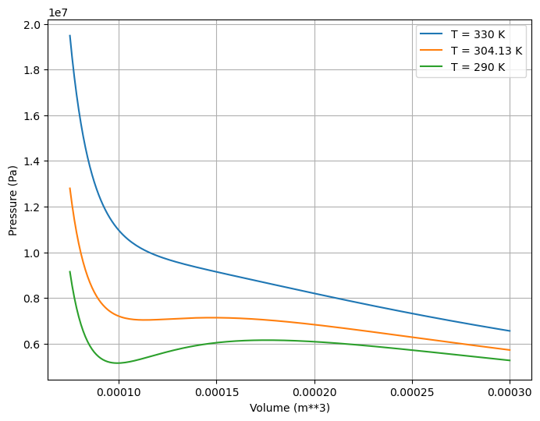
Looks like an Ideal Gas
Not so much like and Ideal Gas
Not really physical because we didn’t include the liquid-vapor region right

Slide 55
END

Slide 58
Question 123.15.1
Each degree of freedom contributes how much energy?

Slide 59
Question 123.15.2
In the kinetic theory of gasses, what is temperature?
how much heat you have
the average internal kinetic energy of the gas
the average potential energy of the molecules
the average momentum of the molecules

Slide 60
Question 123.15.3
Two containers hold an ideal gas at the same temperature and pressure. Both containers hold the same type of gas but container B has twice the volume of container A. The average translational kinetic energy per molecule in container B is
Twice that for container A
The same as that for container A
Half that of container A
Can’ Tell

Slide 61
Question 123.15.4
Approximately what is the average velocity of the molecules in this room?
478m/s
1901m/s
101005m/s
0m/s

Slide 62
Diatomic Molecule
z
y
x

Slide 63
Rotational Degrees of Freedom
z
y
x

Slide 64
Vibrational Degrees of Freedom
z
y
x

Slide 65
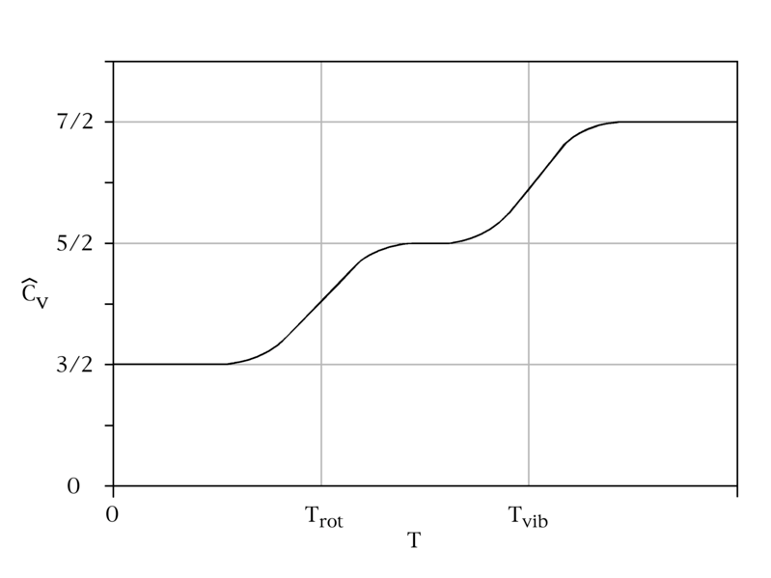
C_{v} vs Temperature

Slide 66
Energy States of a Diatomic Molecule
Available Energy States
Vibrational State
3p
Electronic
State
Roptational State
Increasing Energy
Possible Energy Transitions
2s
Electronic
State

Slide 67
Model of a Solid
z
y
x

Slide 68
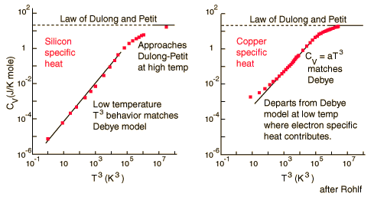
Dulong and Petit Law
http://hyperphysics.phy-astr.gsu.edu/Hbase/thermo/dulong.html

Slide 69
